Slide 1
760 Yelp Data Exploration
Team 10
Lizhi Hu / Zihao Li
Mindy Ma / Yiting Wang

Slide 2
Contents
01
02
03
04
05
06
Research Question
Hypothesis
Data Obtained
SQL Code
Visualization
Conclusion

Slide 3
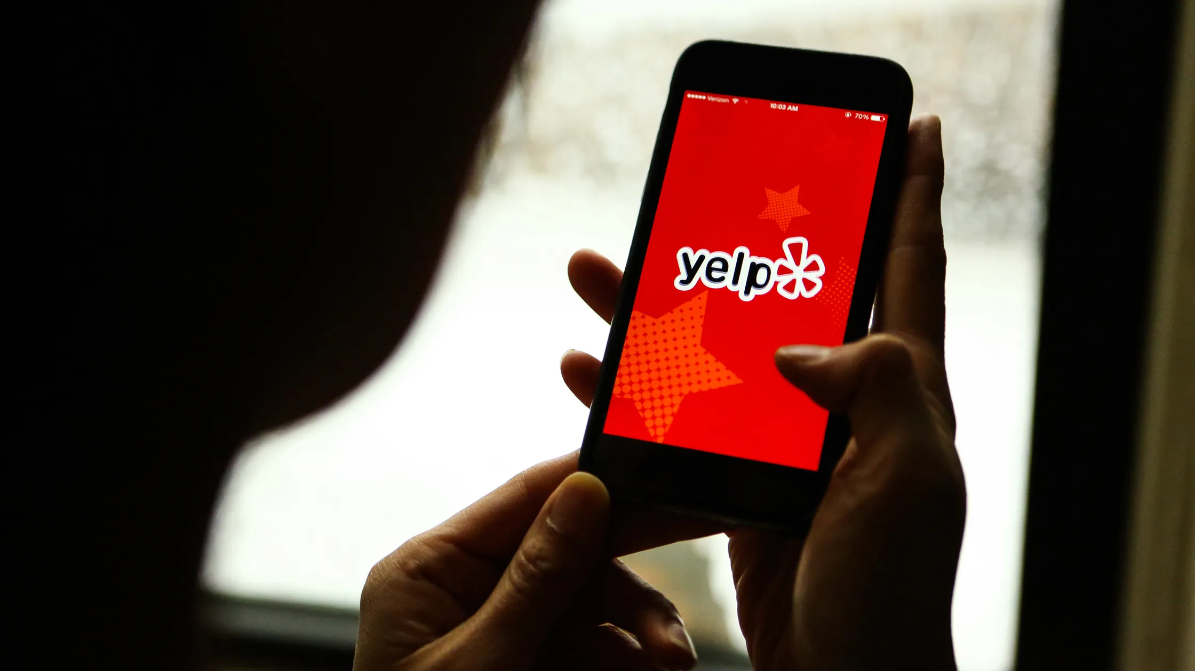
Research Question
Do states with higher household incomes have higher average star ratings on Yelp?

Slide 4
01
Motivation
We hope by analysing the Yelp data and combined with secondary data, we can gain some meaningful business insights. And our goal is to offer tailored business recommendations for individual companies, helping them to strategize more effectively and achieve greater success.

Slide 5
01
Hypothesis
States with higher household incomes tend have higher average star ratings on Yelp because businesses in these affluent states often have more standardized management systems.

Slide 6
Data Obtained
03
Yelp Dataset
Statista Dataset
The Yelp dataset is a subset of our businesses, reviews, and user data for use in connection with academic research.
Link:
https://www.yelp.com/dataset
Median household income in the United States in 2022, by state(in 2022 U.S. dollars)
Link: https://www.statista.com/statistics/233170/median-household-income-in-the-united-states-by-state/

Slide 7
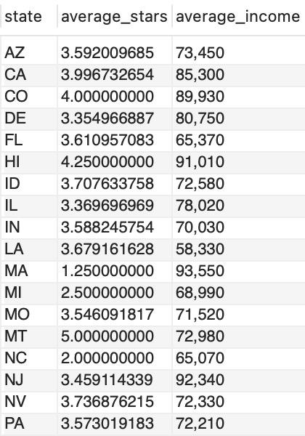
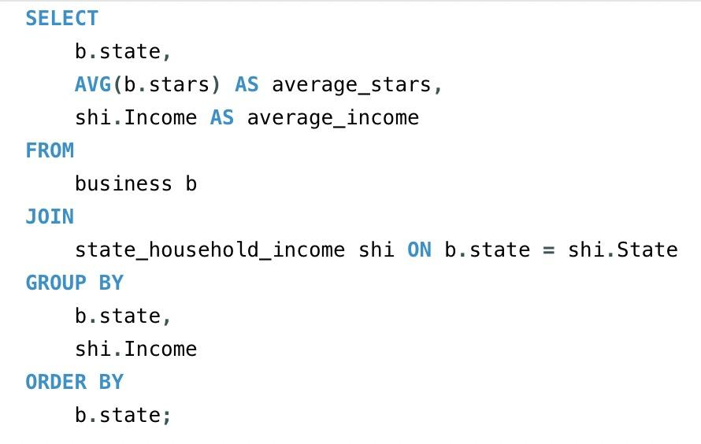
01
SQL Code
04

Slide 8
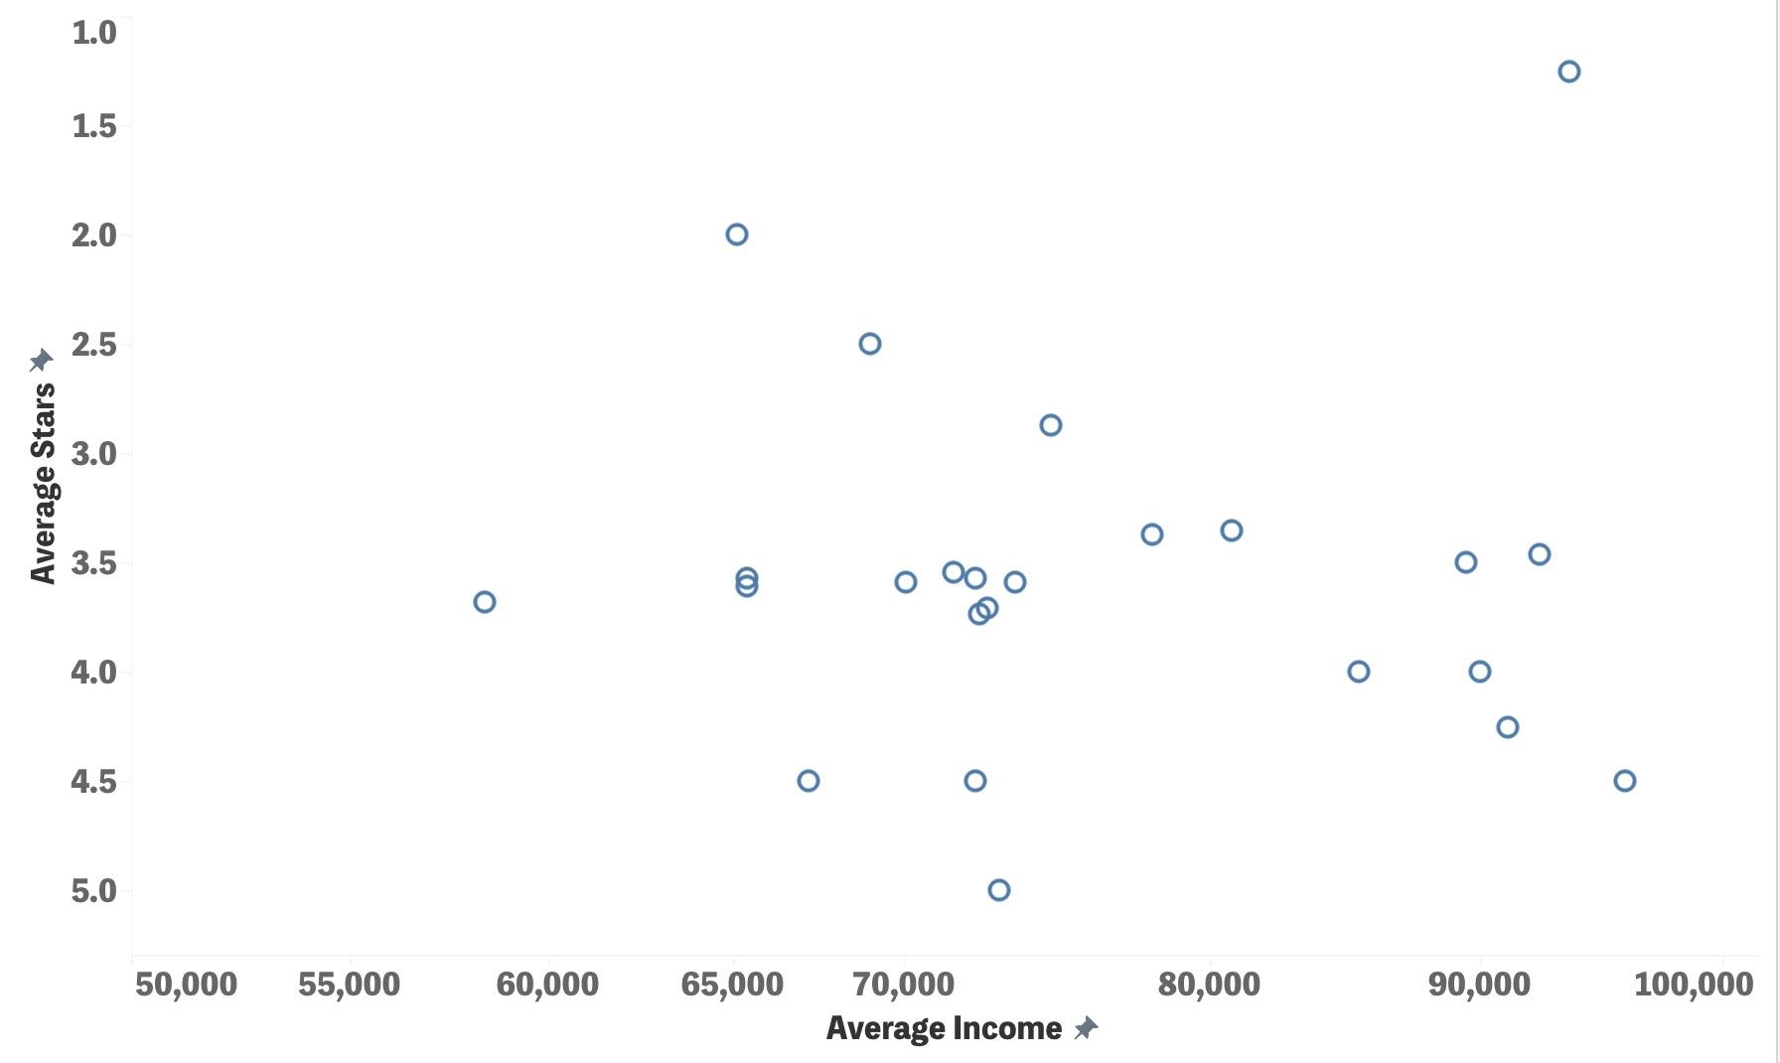
Visualization
05

Slide 9

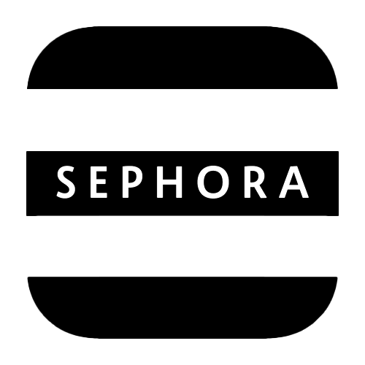

Three Industries
Fast Food Industry
McDonald’s
Cosmetics and Beauty Industry
Sephora
Coffeehouse and Beverage Industry
Starbucks

Slide 10
McDonald’s

Slide 11
Hypothesis
States with higher income levels may have lower star ratings in McDonald’s.

Slide 12
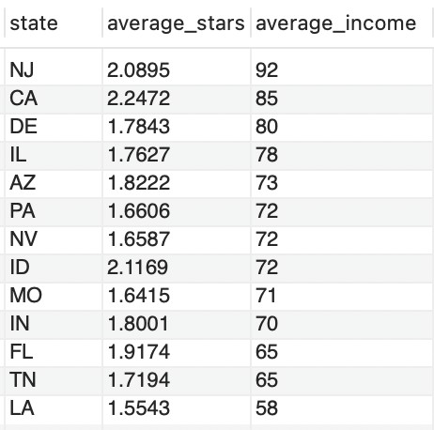
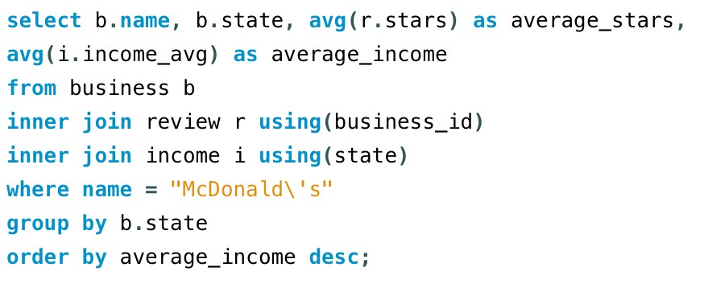
01
SQL Code

Slide 13
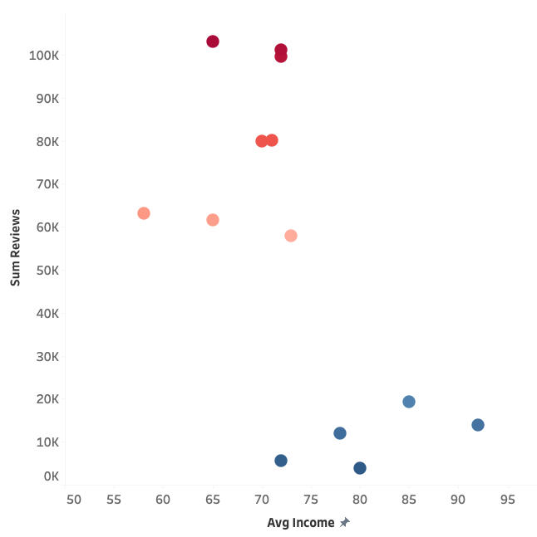
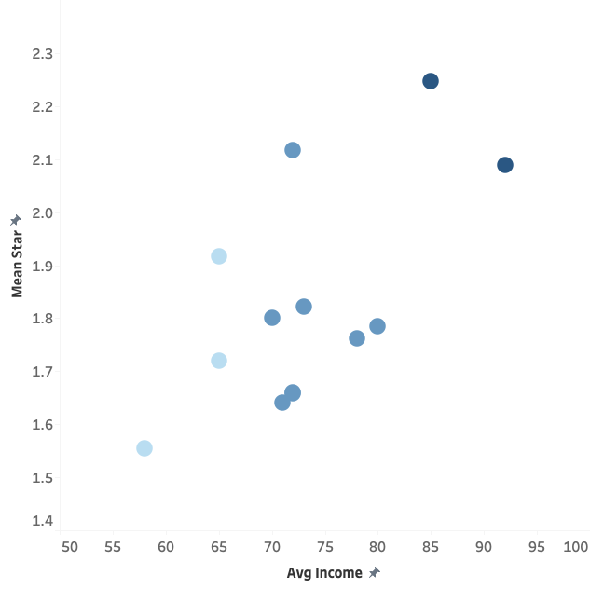
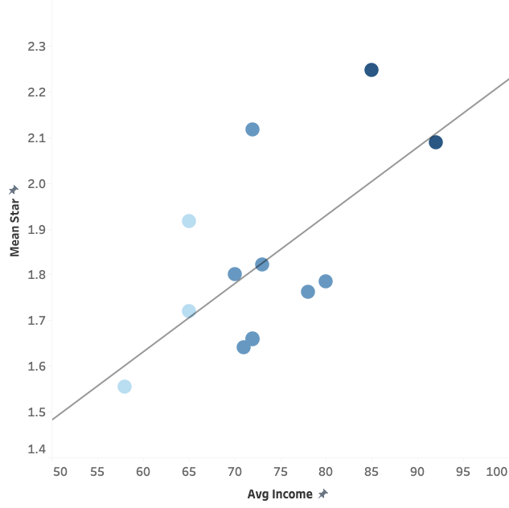
Mcdonald’s

Slide 14
Budget Allocation for New Branch Expansion
 | Problem | Recommendation
Lower-income state | Low average star rating | Service, staffing
Higher-income state | Fewer number of reviews | Location, advertisement
Notes:
In higher-income areas, Starbucks' low star ratings may reflect high consumer expectations for quality and service. Higher-income customers may be more focused on the actual coffee shop experience rather than just the brand name. A highly competitive environment may also affect Starbucks' performance, as high-end coffee shops and local brands may offer options that are more in line with local tastes and culture in terms of service, product quality, or environment. Differences in culture and taste preferences may make Starbucks' standardized offerings unattractive in higher-income areas, while local and specialty coffee shops are preferred. Social and cultural factors may also play a role; if Starbucks fails to cater to local social needs and cultural climates, consumers may prefer more adaptable competitors. In addition, the brand may have reached saturation in some regions, leading to a decline in consumer interest in Starbucks in higher-income areas, compared to lower-income areas that may be more attracted to Starbucks because they view it as a luxury or high-quality experience.

Slide 15
Sephora
Notes:
Hi, I’m Isa. The next brand I’m going to talk about is Sephora.

Slide 16
Hypothesis
The states with higher income would have higher stars.
Notes:
Our hypothesis is the states with higher income would also have higher stars.

Slide 17
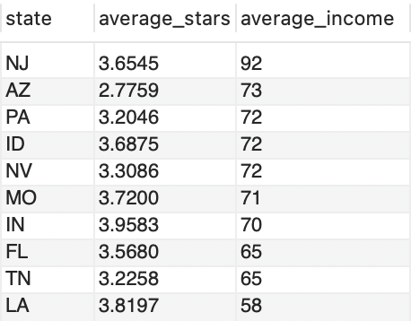
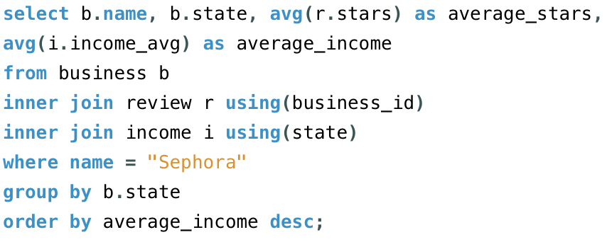
01
SQL Code
Notes:
Here’s the SQL code, ordered by average income.

Slide 18
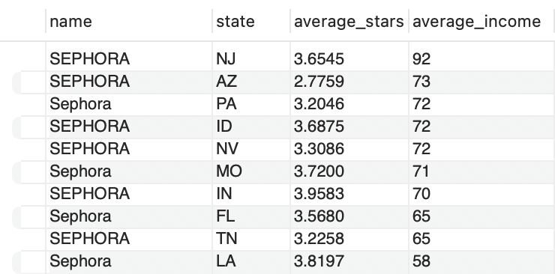
Sephora
1.
2.
Notes:
In this table, we could identify that the top and 2nd rating stars is not in the high-income state, which is different from our hypothesis.

Slide 19
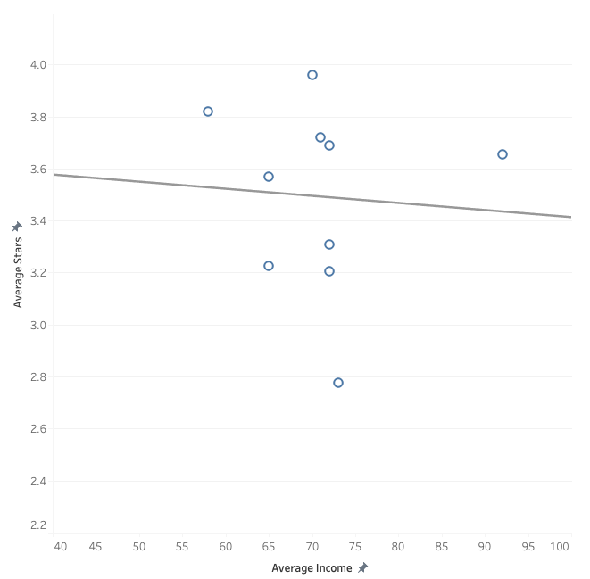
Visualization
Notes:
In this table, we could see that the top and 2nd rating stars is not in the high-income states, which is different with our hypothesis.
Moreover, we could see this scatter plot shows that there’s indeed a slight negative relation between income and stars rating.
From the Sephora’s perspective, we have a recommendation for boosting the stars and reviews. Our target audience would be high-income groups who has lower stars rating. Because high-income customers are more sensitive with the service rather than small sales, we provide the special member campaign.

Slide 20
Boost our stars and reviews!
Special membership campaign!
5 stars for a special membership service.
20% off discount per purchase (over $100)
Priority Access (prior purchase before sale start)
Notes:
The special member campaign is that anyone who have mentioned 5 stars over 5 times, they would be eligible for this membership.
We provide two service for the member. The first is 20% off in every purchase over $100. This is also the biggest discount among all Sephora membership. The second one is priority access. In the sale season, the regular customers could buy a product only starting at 12:00 a.m., but special members are granted the privilege of ordering the products three hours earlier. We’re convinced that by doing so, the stars and reviews will increase.

Slide 21
Starbucks
Hypothese:
States with higher income levels can be associated with higher Starbucks presence or success metrics.

Slide 22
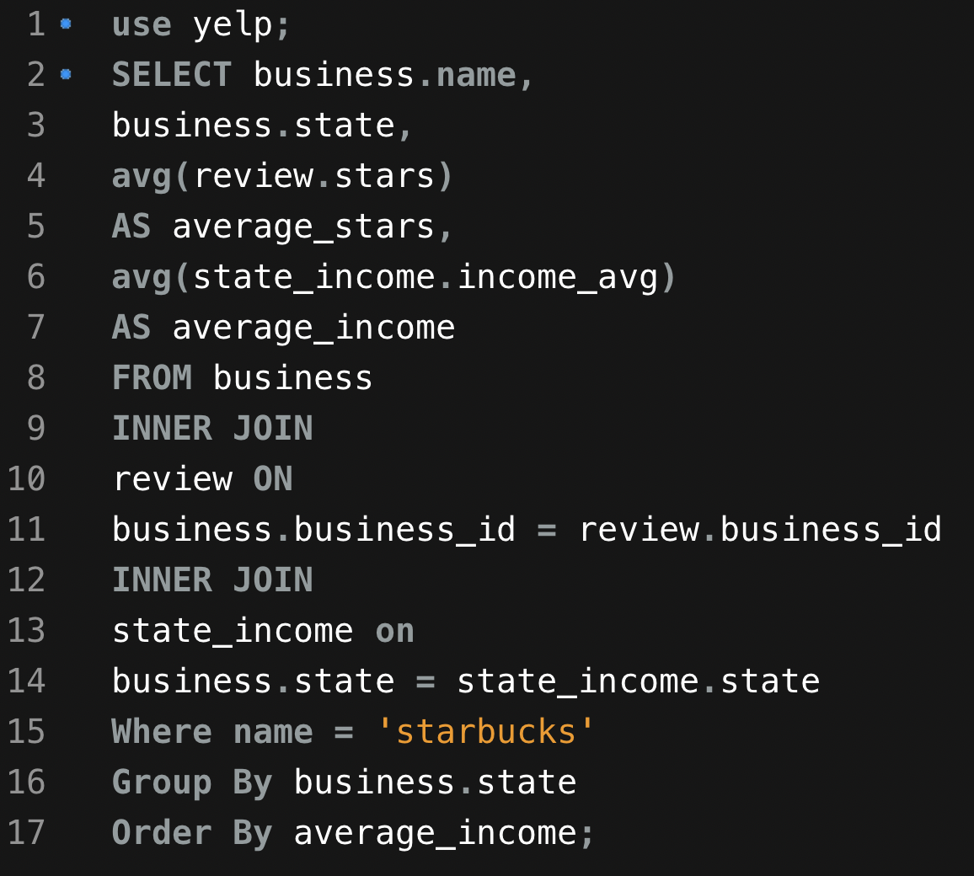
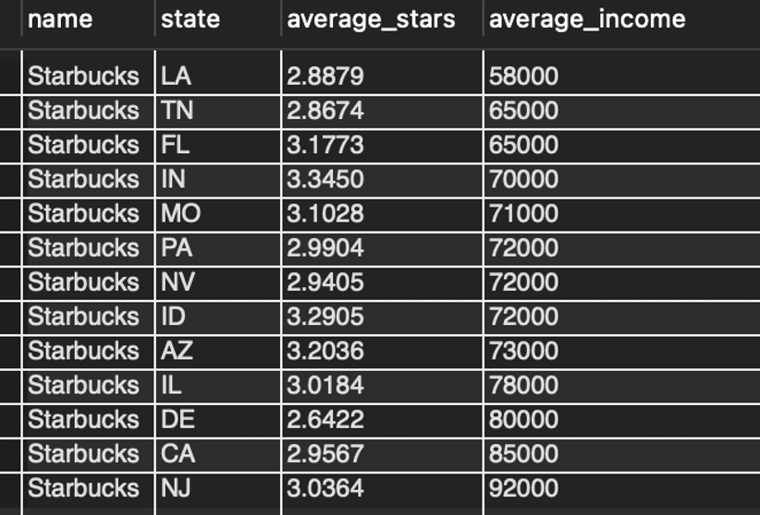
Starbucks

Slide 23
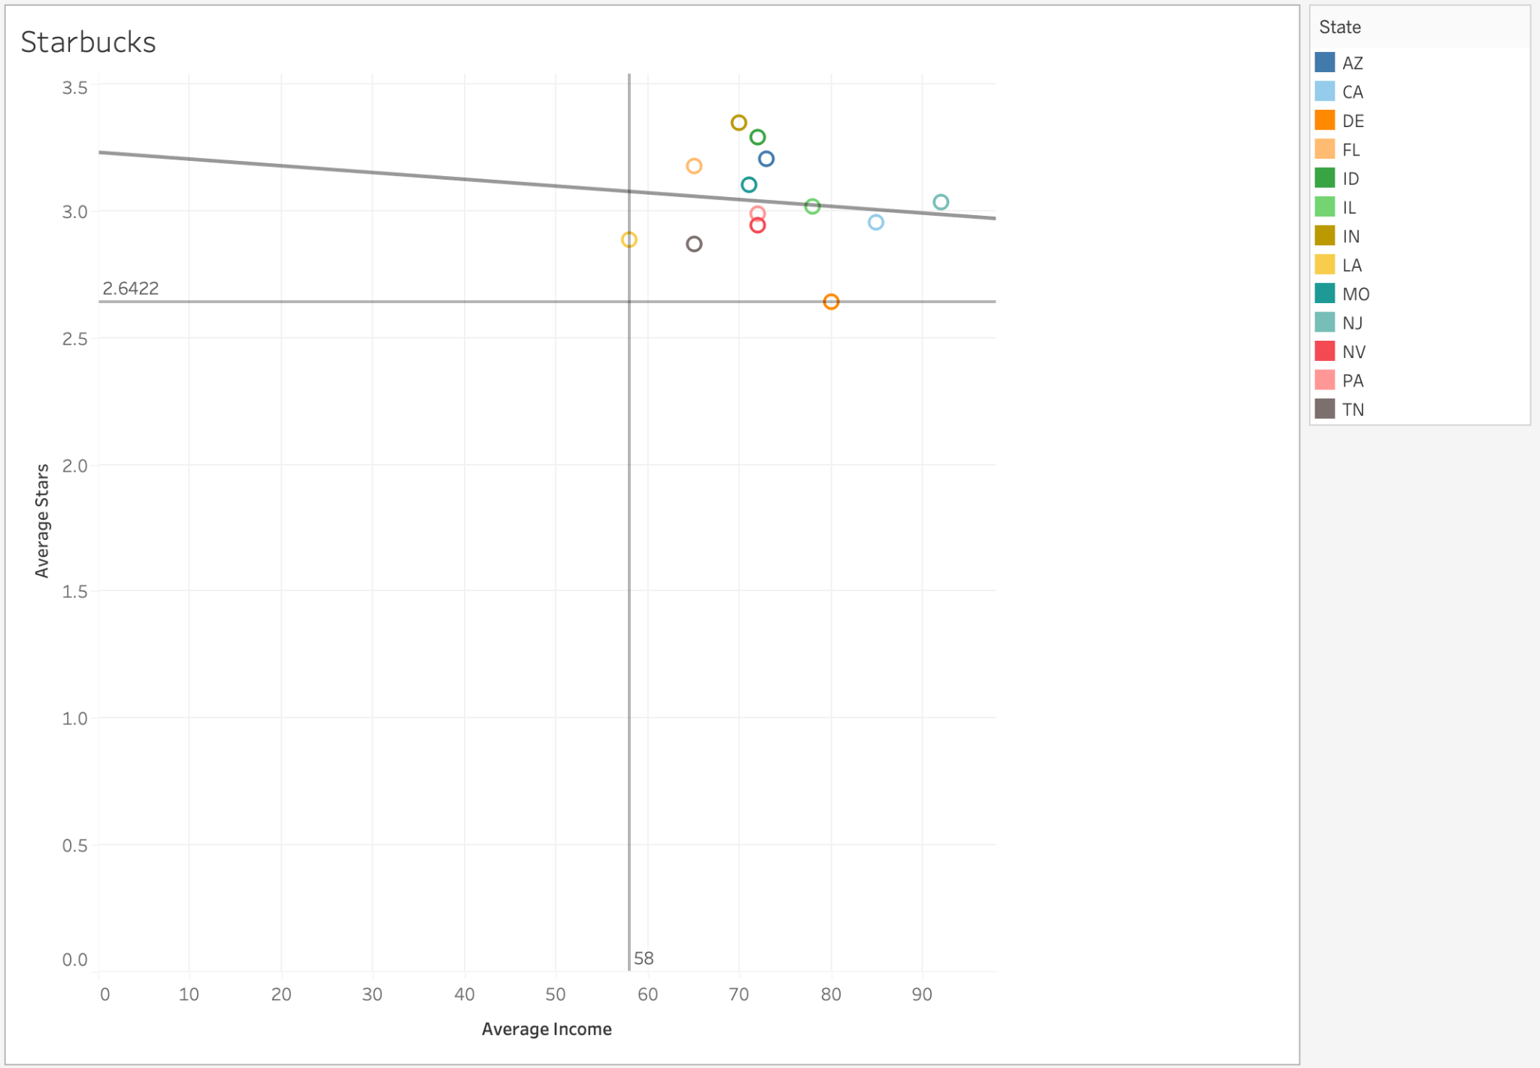
Starbucks

Slide 24
Starbucks Conclusions
Price sensitivity
Competitive environment
Cultural and Taste Preferences
Social and Cultural Factors
Brand Saturation
Notes:
In higher income areas, people ask for high expectations for quality and service and
Local competition and cultural differences make standardized offerings less appealing.
Didn’t adapt to local needs and possible saturation in some regions contribute to declining interest,
lower-income areas might be see Starbucks as a luxury experience.

Slide 25
Starbucks Recommandation
Adapt Offerings to Local Tastes
Elevate Customer Experience
Competitive Edge and Innovation
Notes:
Starbucks can enhance its performance in higher-income areas by tailoring its menu to local tastes, elevating the customer experience, and strategically innovating to stay competitive.

Slide 26

Conclusions
leverage income levels to tailor distinct strategies tailored to specific industries.
Notes:
Use income levels to create customized strategies for different industries.

